Slide 1

Genome-Phenome analysis of neoplasia-related traits across the primate phylogeny
27-09-2021
Alejandro Valenzuela, David Juan, Gerard Muntané, Arcadi Navarro
Comparative and evolutionary genomics lab

Slide 2
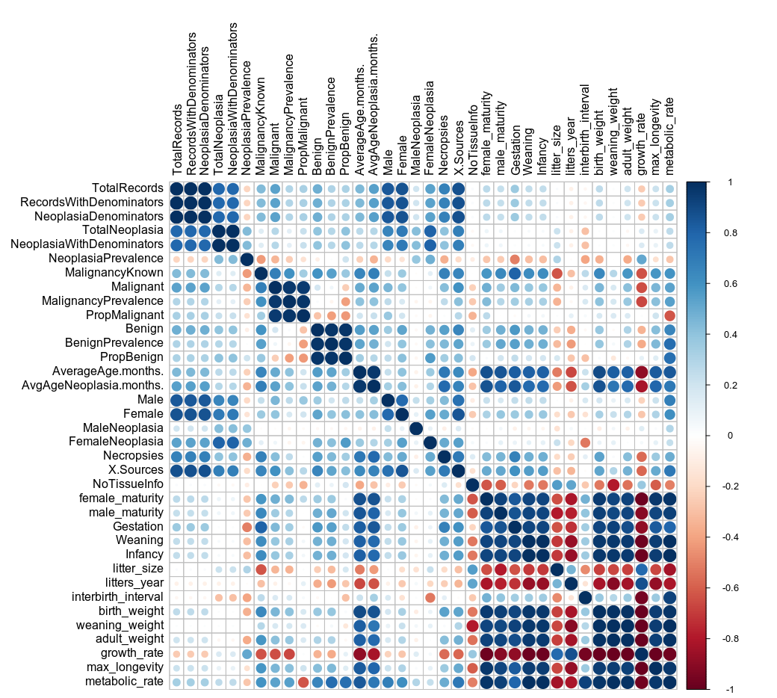
Neoplasm proportions as phenotypes of interest
Started working with 3 main clusters of neoplasm rates:
A) General Neoplasia
B) Malignancy
C) Benignancy
A
We focus on protein-coding regions and look at -only- two* potential genomic sources of phenotypic variation:
Candidate Convergent Amino Acid Substitutions (CAAS).
Correlations between rates of protein evolution and traits, using Phylogenetic-Generalized Least Squares (PGLS)
We use a new dataset, with includes only species with >10 observations (more reliability, less diversity of species).
B
C
*so there’s lots more to look at!

Slide 3
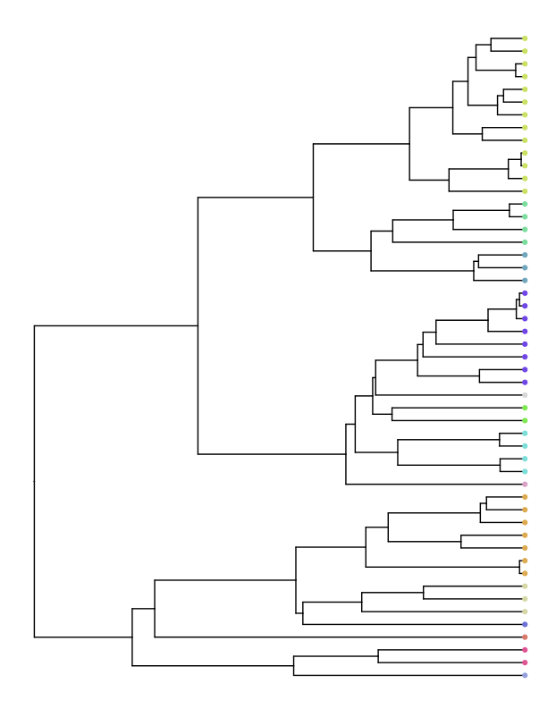
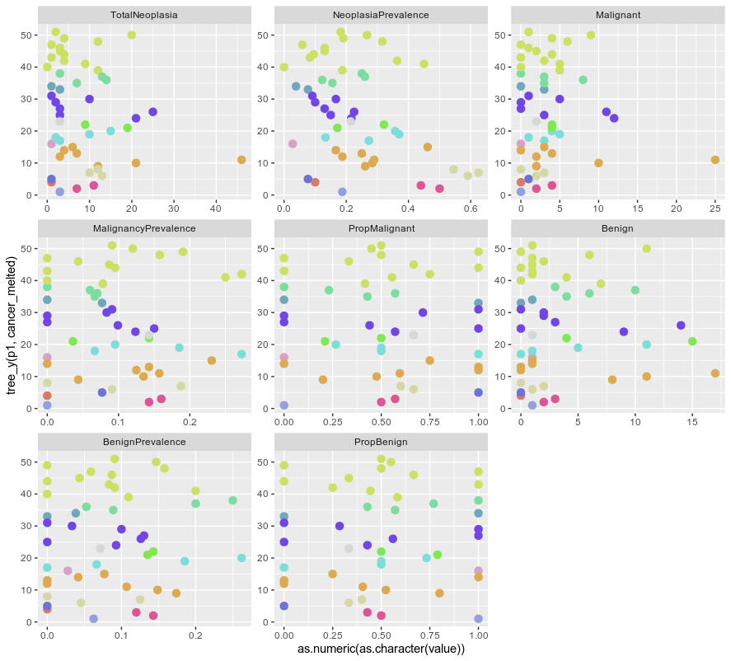
We observe extreme species within primate family clades (as we did with the previous dataset)
Every family labelled with a different colour

Slide 4
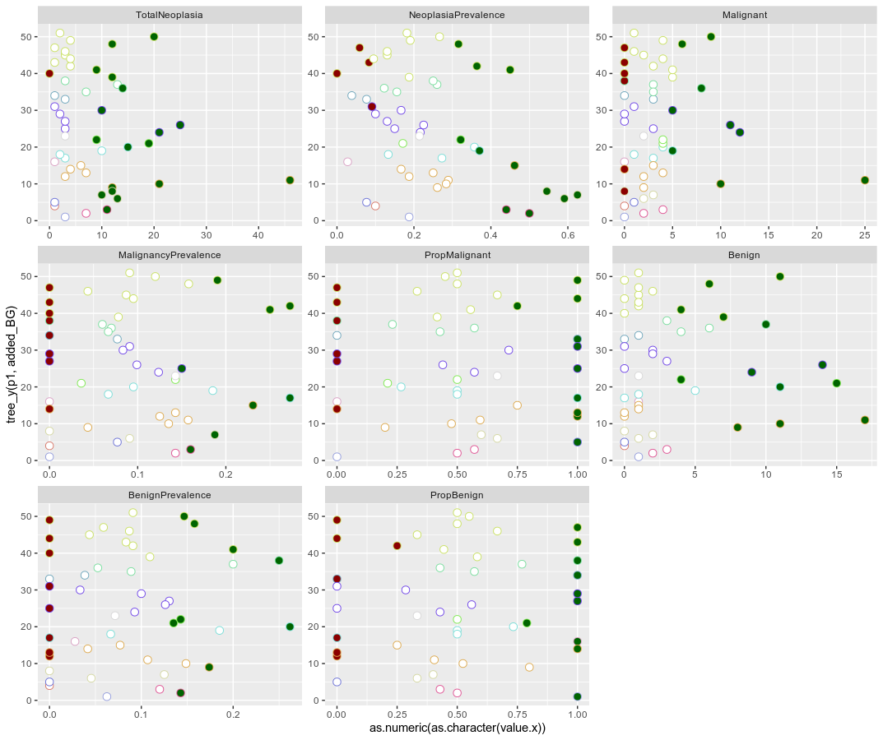
We observe extreme species within primate family clades (as we did with the previous dataset)
Every family labelled with a different colour

Slide 5

Data quality: a new balance
With the new filtering at the species level, there are two different impacts:
Reduction at the species-level accuracy. Representative species from the same genus are selected.
Improvement of the trait dataset quality, with more reliable measurements as mean species values.
10 measurements x species,
balanced trade off

Slide 6
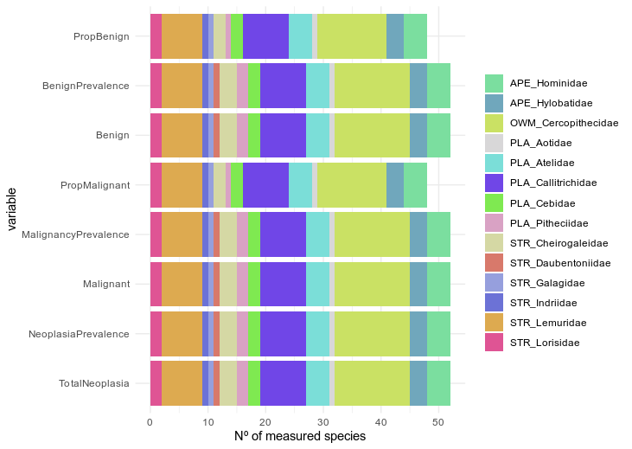
Data quality: a new balance
With the new filtering at the species level, there are two different impacts:
Reduction at the species-level accuracy. Representative species from the same genus are selected.
Improvement of the trait dataset quality, with more reliable measurements as mean species values.
52 primate species
14 primate families

Slide 7
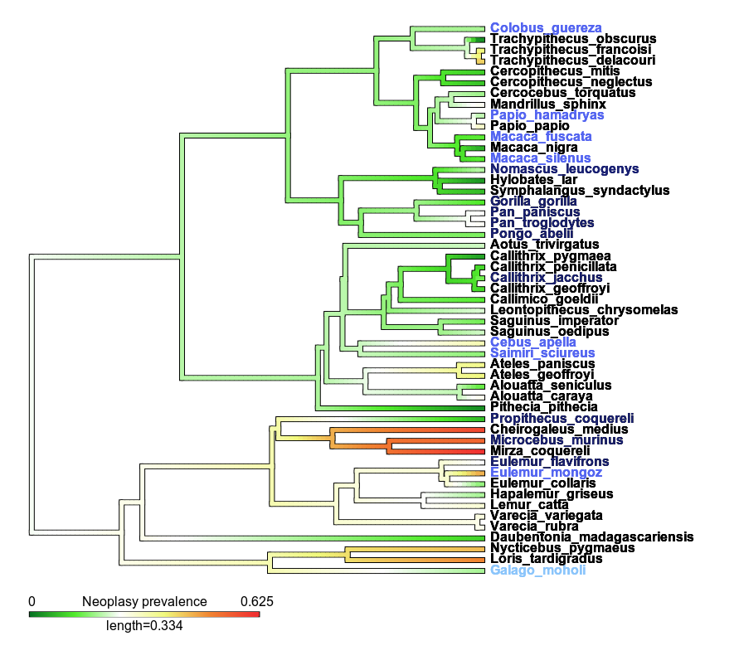
Available Genomes
ONLY* 9 species with
available UCSC genomes
7 species with genomic data for closest genus representative
1 species with genomic data for closest family representative
*so we are only scratching the surface here!
Phylogenetic distribution of Neoplasia Prevalence values

Slide 8
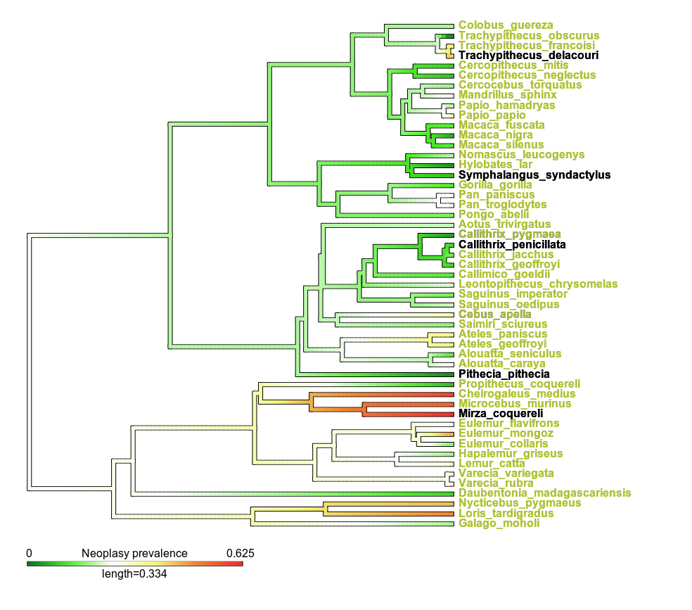

Eventually, we will be able to add...
~37 species with genomic data for genomes coming from the
Primate Sequencing Initiative Consortium (PSIC)
Phylogenetic distribution of Neoplasia Prevalence values

Slide 9
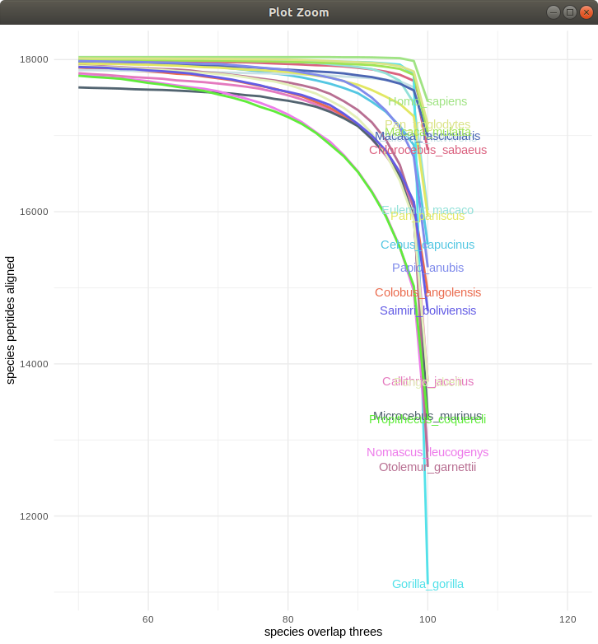
Final genomic dataset
The analyzed dataset is formed by 16,343 best quality transcript alignments representing a human gene.
This is our reference genomic dataset for trait analysis.

Slide 10
Discovery of Convergent Amino Acid Substitutions (CAAS)
Discovery of candidate CAAS, focusing on two scenarios, so geared to detecting AA changes linked to Phenotype Group A (e.g., higher neoplasia prevalences)
Scenario 1
Scenario 2
Species 1 ---- P S T V Q L M P
Species 1 ---- P S T V Q L M P
Phenotype group A
Phenotype group A
Species 2 ---- P S T V Q L M P
Species 2 ---- P S T V Q L M P
Species 3 ---- P S T V Q L M P
Species 3 ---- P S T V Q L M P
Species 4 ---- P Q T V Q - M P
Species 4 ---- P S R V Q - M P
Phenotype group B
Phenotype group B
Species 5 ---- P Q T V Q L M P
Species 5 ---- P S P V Q L M P
Species 6 ---- P Q T - Q L M P
Species 6 ---- P S M - Q L M P

Slide 11
Internal Validation of Convergent Amino Acid Substitutions (CAAS)
Phylogeny-guided resampling validation
Resampling 1 | Top species | Bottom species
Trait A | Eulemur rufifrons Macaca nigra | Macaca fuscata Colobus angolensis Cheirogaleus medius Pan troglodytes Indri indri Saimiri sciureus Otolemur garnettiii
Observed family proportions
e.g. | Top species | Bottom species
Trait A | Lemur catta Cercopithecus dephus | Erythrocebus patas Macaca arctoides Cheirogaleus major Pan paniscus Propithecus coquereli Saimiri boliviensis Galagoides demidovii
Resampling 2 | Top species | Bottom species
Trait A | Eulemur collaris Piliocolobus badius | Presbytis comata Semnopithecus entellus Microcebus murinus Pan paniscus Propithecus diadema Cebus albifrons Galago moholi
...
Resampling N | Top species | Bottom species
Trait A | Eulemur macaco Macaca fuscata | Trachypithecus phayrei Papio papio Mirza zaza Gorilla gorilla Avahi laniger Cebus olivaceus Galago senegalensis
Each color represents a distinct primate family
Primate family proportions from the observed groups are kept in the resampling procedure
The larger the clade depth, the larger the power to validate AA positions associated to the trait

Slide 12
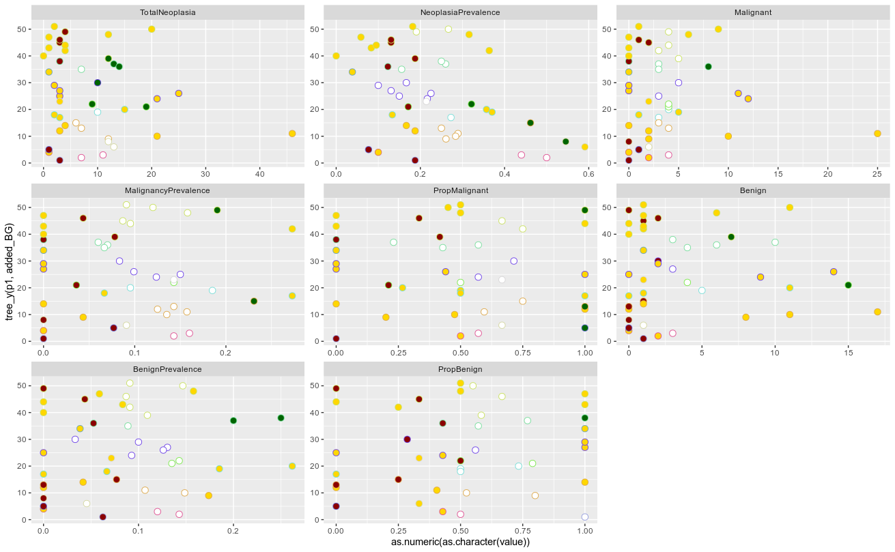
Convergent Amino Acid Substitutions (CAAS)
Phylogeny tip order
Trait value

Slide 13
Convergent Amino Acid Substitutions (CAAS)
Phylogeny tip order
Illumina extreme species
UCSC low-extreme/top-extreme
By selecting species with ~1 MAD*
*Median Absolute Deviation (from the median both of the family and the global trait distribution)
Trait value

Slide 14
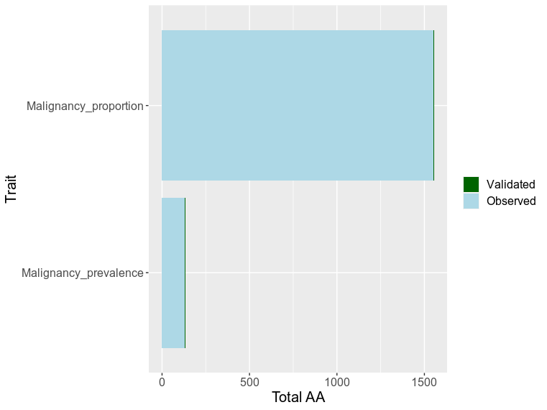
Convergent Amino Acid Substitutions (CAAS)
Malignancy measurements
AA discovery + individual validation
 | Top species | Bottom species
Malignancy prevalence | Eulemur mongoz Papio hamadryas | Colobus guereza Macaca silenus Microcebus murinus Pan paniscus Propithecus coquereli Samiri sciureus Galago moholi
Malignancy proportion | Eulemur flavifrons Papio hamadryas Propithecus coquereli | Colobus guereza Macaca silenus Pan paniscus Samiri sciureus Galago moholi
CHANGE GRAPH
1,688 Putative CAAS discovered (134 Malignancy prevalence + 1,554 Malignancy proportion)
703 genes harboring CAAS out of 16,343 alignments (104 Malignancy prevalence + 599 Malignancy proportion)

Slide 15
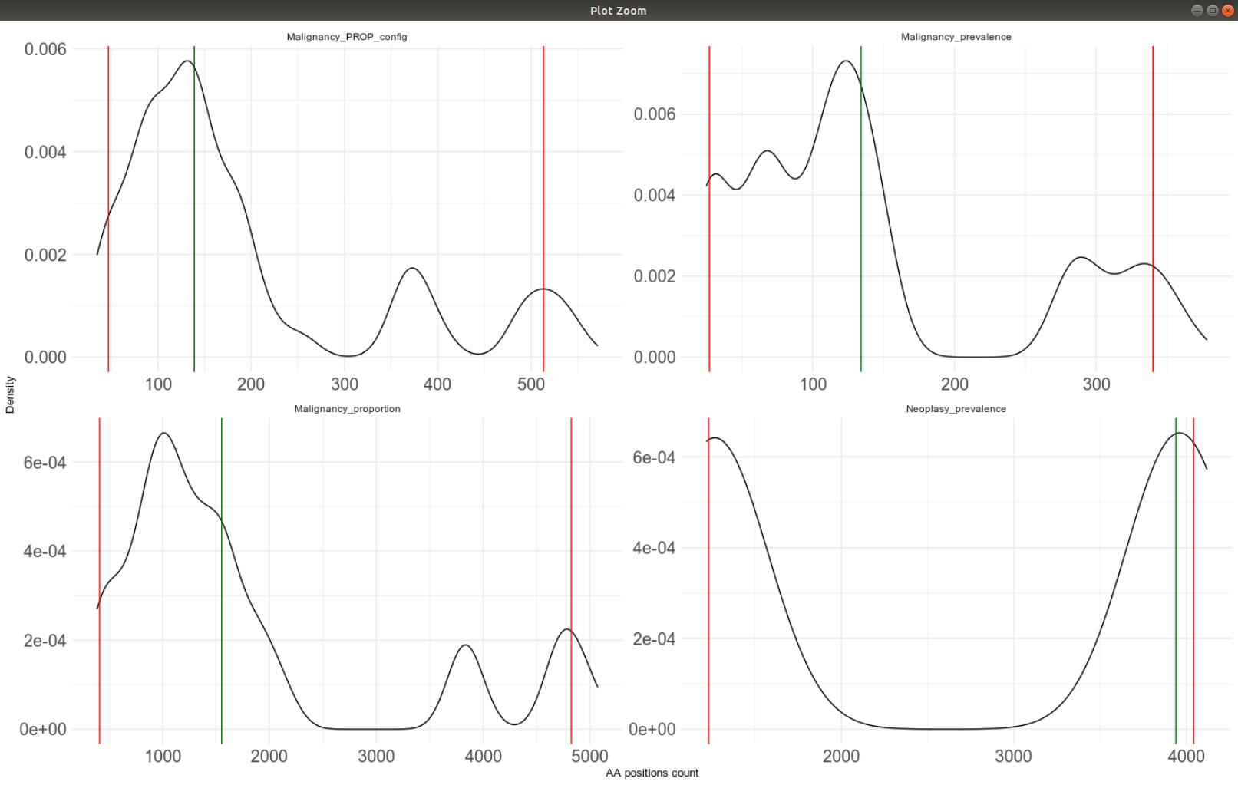
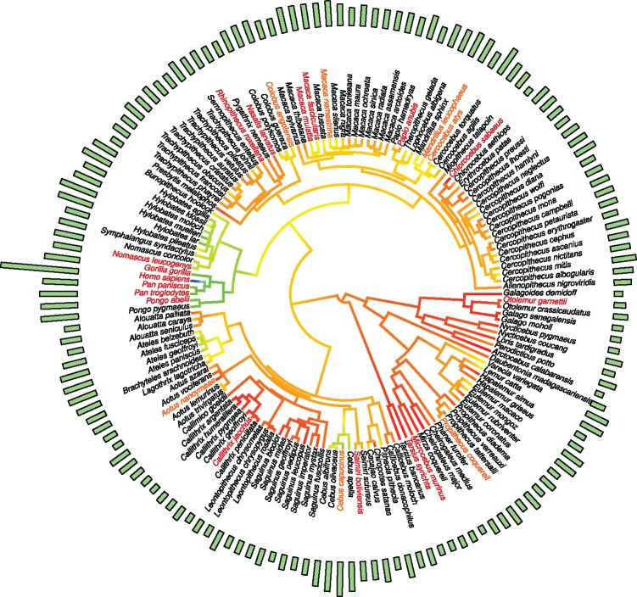
Convergent Amino Acid Substitutions (CAAS)
Malignancy proportion
Amino Acid association excess
Observed nº AA discovered
<0.05 significance area
No excess observed
Even if lack of significant excess due to lack of power (current # of available species aligned), associations found may still be of relevance
Malignancy prevalence
Muntané et al. (2018). Biological processes modulating longevity across primates: A phylogenetic genome-phenome analysis. Molecular Biology and Evolution
Total nº AA

Slide 16
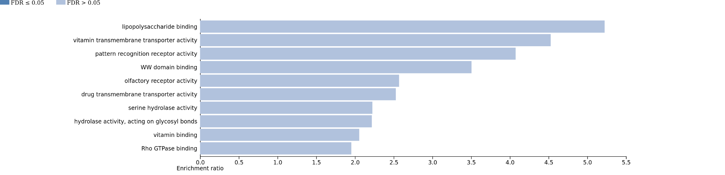
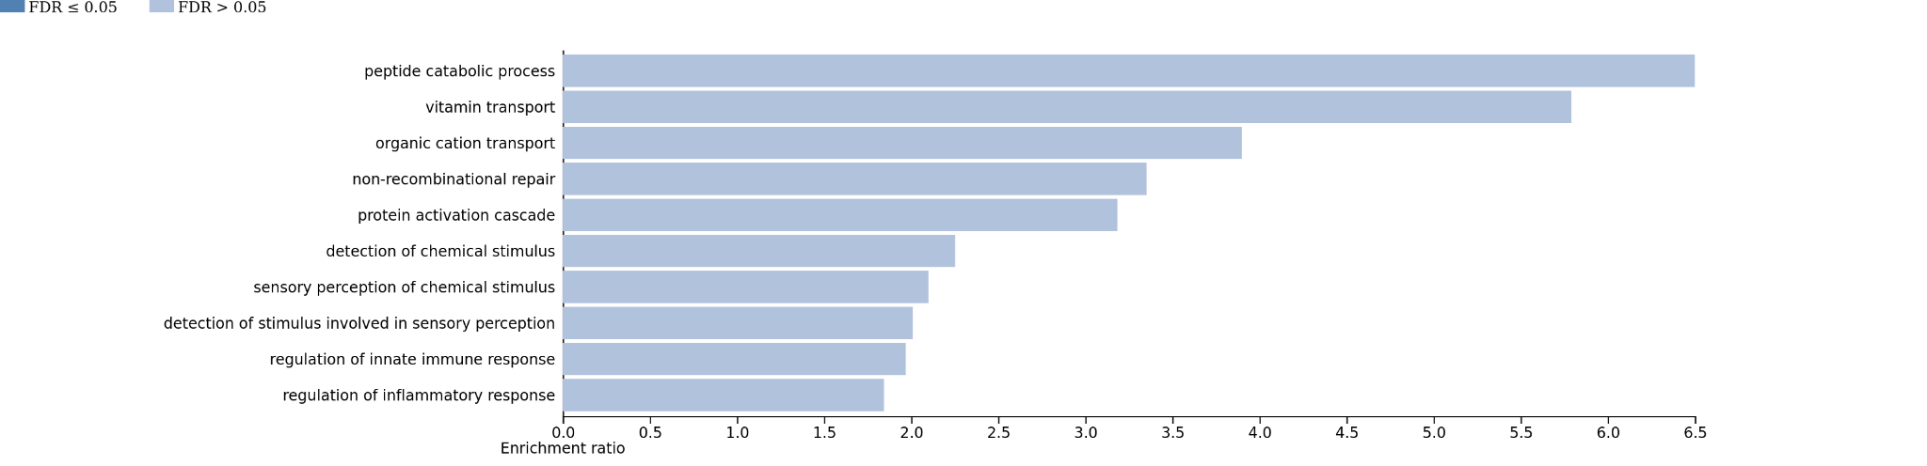
Convergent Amino Acid Substitutions (CAAS)
Biological process
In-silico functional analysis
GO enrichment analysis
WebGestalt
http://www.webgestalt.org/
(Analysis performed upon Discovered CAAS)
Reference set to 16,343 genes
Molecular function
*in green, enrichment categories with several neoplasic genesets

Slide 17
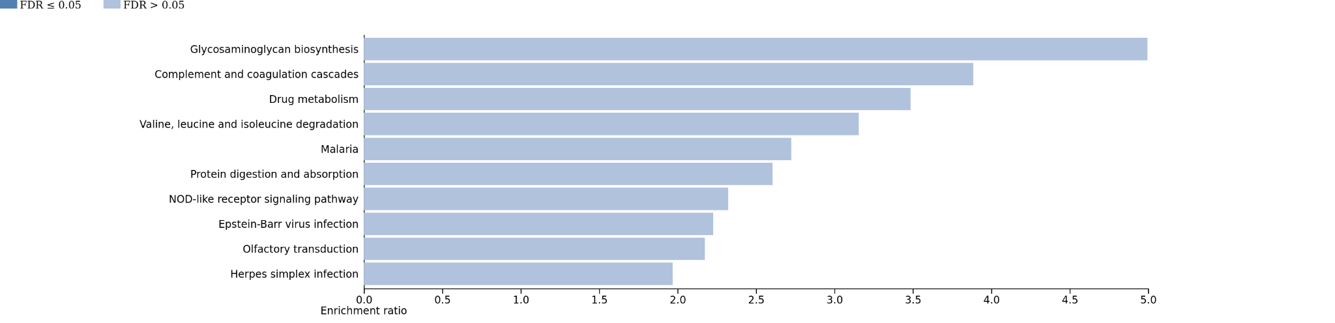
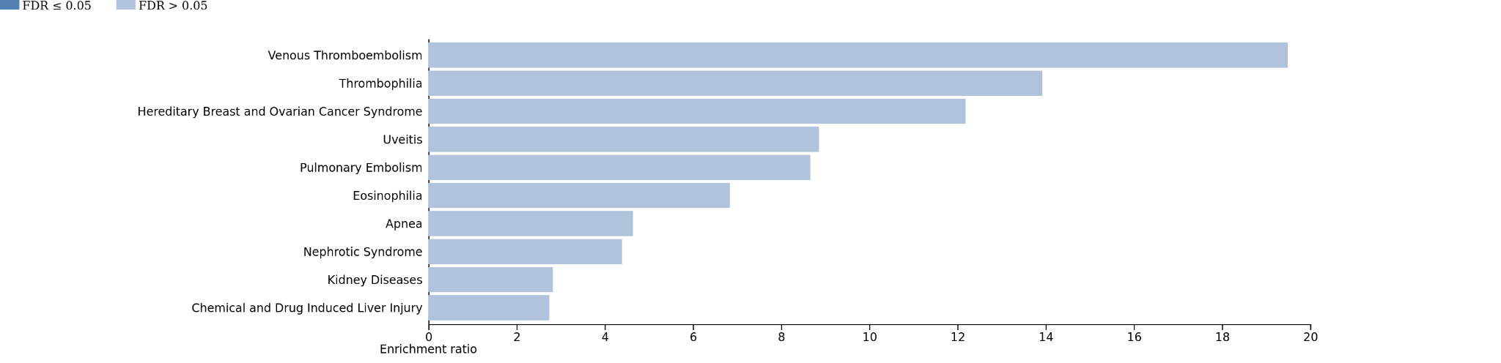
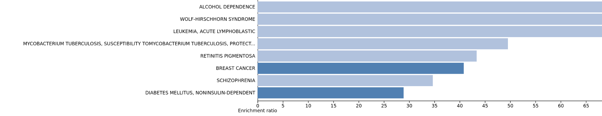
Convergent Amino Acid Substitutions (CAAS)
KEGG 2021: Biological pathways
In-silico functional analysis
Pathway and disease enrichment analysis
WebGestalt
http://www.webgestalt.org/
(Analysis performed upon Discovered CAAS)
Reference set to 16,343 genes
Disgenet & OMIM dieseases DB
*in green, enrichment categories with several neoplasic genesets

Slide 18
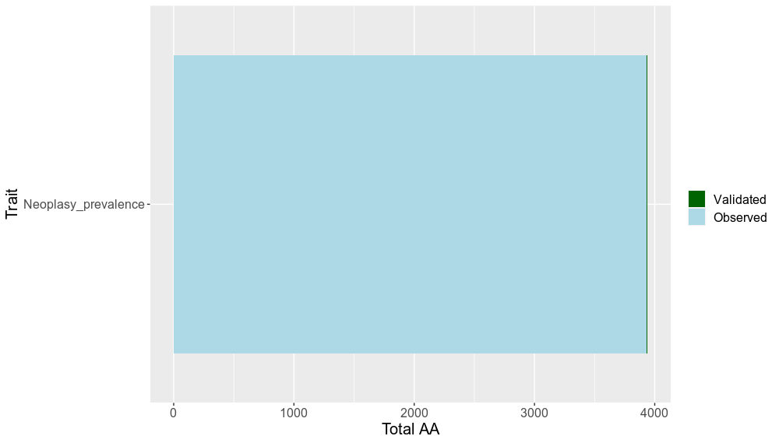
Convergent Amino Acid Substitutions (CAAS)
Neoplasia measurements
AA discovery + individual validation
 | Top species | Bottom species
Neoplasia prevalence | Cebus apella Eulemur mongoz Microcebus murinus | Colobus guereza Macaca fuscata Macaca silenus Gorilla gorilla Propithecus coquereli Samiri sciureus Galago moholi
2,261 gene discoveries out of 16,343 alignments
3,939 AA discovered

Slide 19
Convergent Amino Acid Substitutions (CAAS)
Neoplasia prevalence
Amino Acid association excess
Observed nº aa discovered
<0.05 significance area
Total nº AA

Slide 20
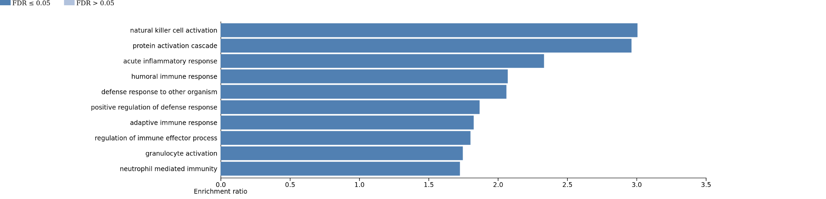
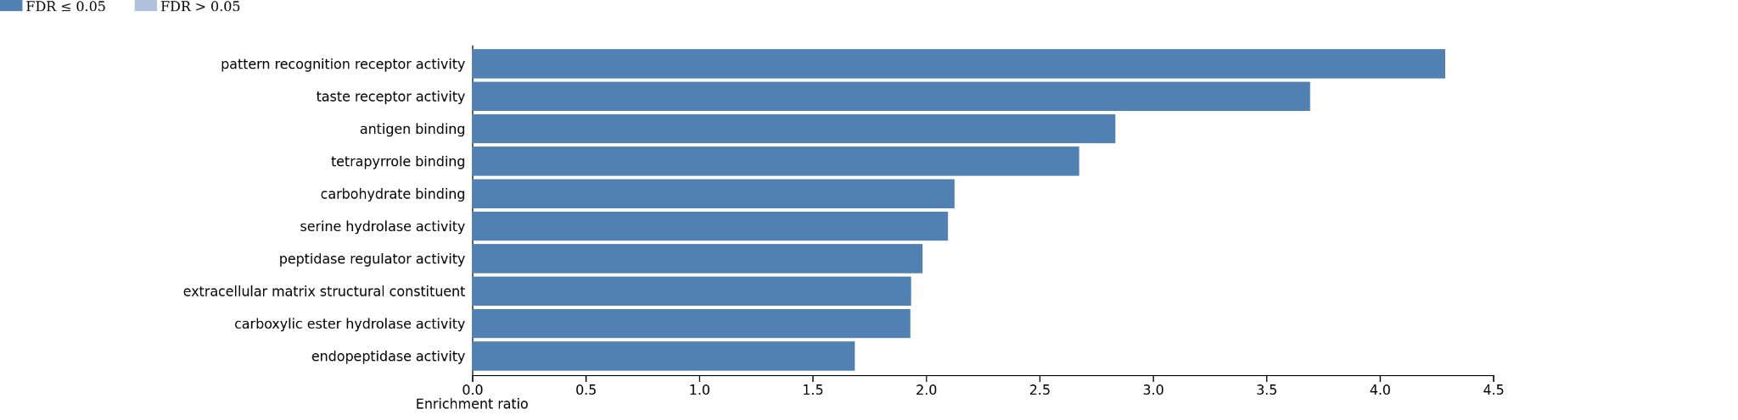
Convergent Amino Acid Substitutions (CAAS)
Biological process
In-silico functional analysis
GO enrichment analysis
WebGestalt
http://www.webgestalt.org/
(Analysis performed upon Discovered CAAS)
Reference set to 16,343 genes
Molecular function

Slide 21
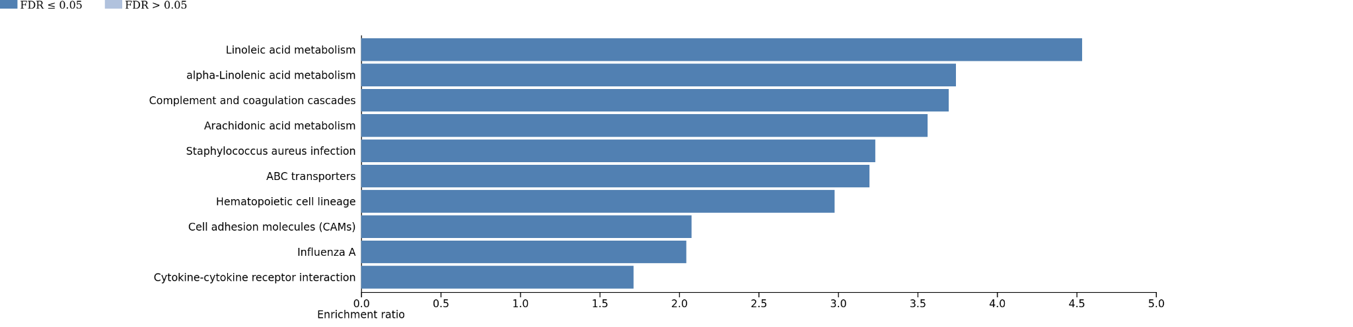
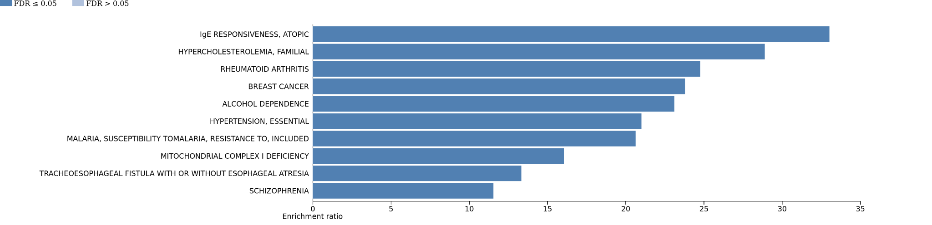
Convergent Amino Acid Substitutions (CAAS)
KEGG 2021: Biological pathways
In-silico functional analysis
Pathway and disease enrichment analysis
WebGestalt
http://www.webgestalt.org/
(Analysis performed upon Discovered CAAS)
Reference set to 16,343 genes
OMIM diseases
*in green, enrichment categories with several neoplasic genesets

Slide 22
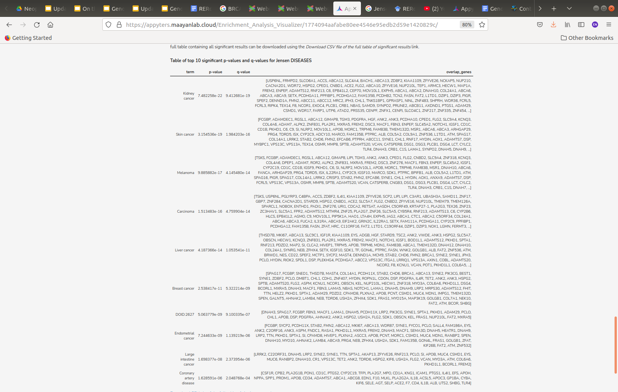
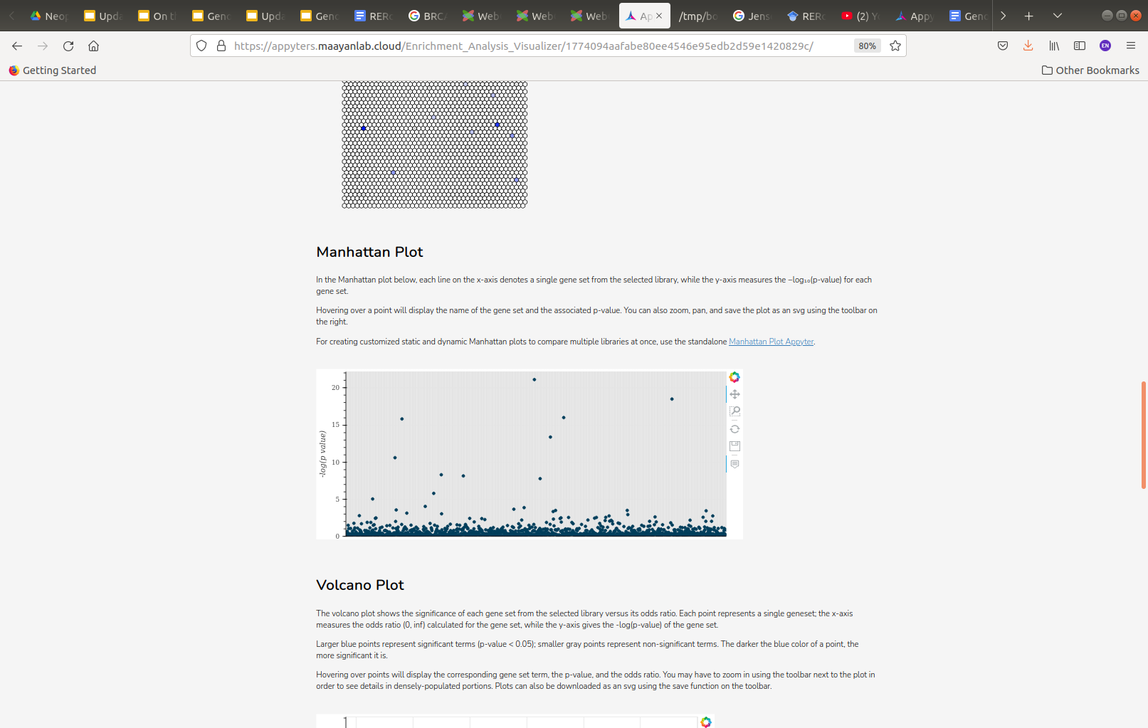
Convergent Amino Acid Substitutions (CAAS)
In-silico functional analysis
disease enrichment analysis
EnrichR
https://maayanlab.cloud/Enrichr/
(Analysis performed upon Discovered CAAS)
JensenDB: Additional dataset focused on several human diseases categories
In the Manhattan plot below, each line on the x-axis denotes a single gene set from the selected library, while the y-axis measures the −log₁₀(p‐value) for each gene set.
Manhattan plot points to several from their cancer categories

Slide 23
Summary of CAAS analysis
Malignancy related-traits represent close selection of extreme primate species, with the exception of Propithecus coquereli, in which genes associated with both traits present AAs associated with an increase of the proportion of Malignancy over Benignancy but an absent increase of their Malignancy rate.
Top cancer-related categories for their genesets are linked to Ovarian and Breast cancer with genes such as BRCA1, RAD51D and BARD1 in the top enrichment list.
Neoplasia prevalence also links to fatty acid metabolism and immunity/inflammatory responses, with a strong signal in cancer categories for one of the available human disease annotation DB (Jensen diseases).

Slide 24
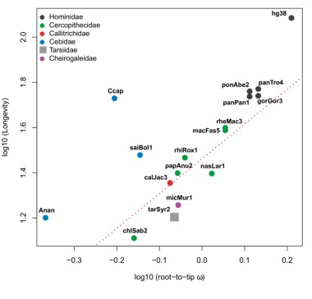
PGLS-based trait-association analysis
(Phylogenetic Generalised Least-Squares, PGLS)
Regression between a genomic variable (in our case, rates of protein evolution, measured as root-to-tip dN/dS) and a trait response variable (e.g., Neoplasia Prevalence) across a phylogeny, controlling for non-independence of species data points.
gene-trait correlations
gene-trait correlations
Muntané et al. (2018). Biological processes modulating longevity across primates: A phylogenetic genome-phenome analysis. Molecular Biology and Evolution

Slide 25
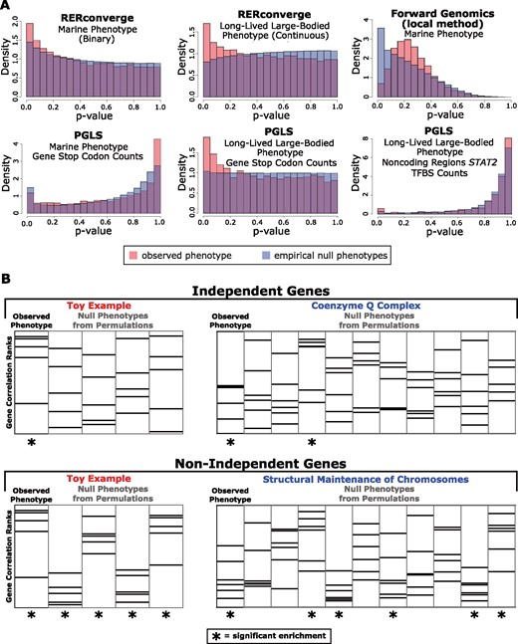
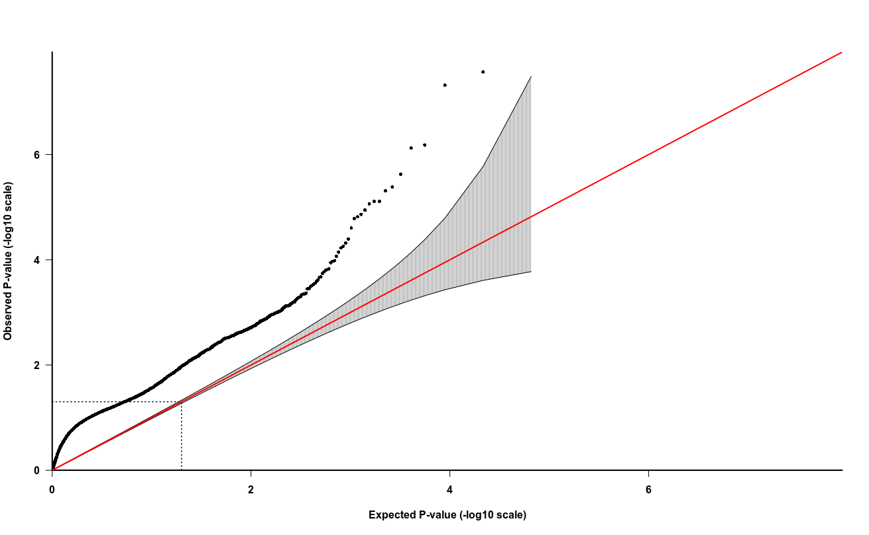
Use of permuLations
For a given phylogenetic comparative method (PCM), such as PGLS, permulations allow to:
explore the space of null expectation for p-values given a particular association method and a particular genomic dataset
recalibrate original p-values obtaining empirical p-values, reducing overestimation or underestimation of correlation significance due to PCM particularities
Neoplasia Prevalence parametric p-values
observed p-value (-log10 scale)
Elysia Saputra, Amanda Kowalczyk, Luisa Cusick, Nathan Clark, Maria Chikina, Phylogenetic Permulations: A Statistically Rigorous Approach to Measure Confidence in Associations in a Phylogenetic Context, Molecular Biology and Evolution, Volume 38, Issue 7, July 2021, Pages 3004–3021
expected p-value (-log10 scale)

Slide 26
Improvements added since last presentation...
Regarding both, the gene predictor (root-to-tip dN/dS) and the relevant trait (e.g., Neoplasia Prevalence):
Genes with half of the species with certain dN/dS values (value of “0”, ~10 species) were not included in the correlation analysis (a value of “0” biases the analysis because it tends to assign the strength of the correlations strength to particular species rather than to phylogenetic trends)
Here we work with the removal of standardized residuals for the raw values of the trait (with several “0” observations, a log10-transformation before the correlation estimation does not lead to a roughly normal or uniform distribution).

Slide 27
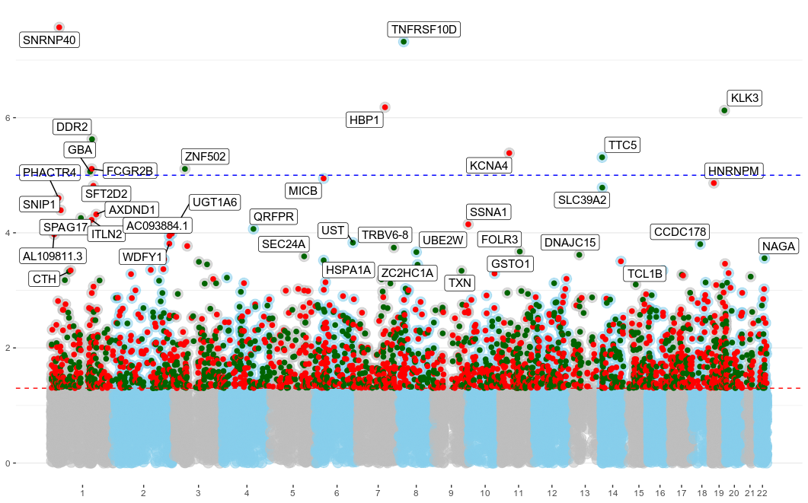
Neoplasia Prevalence
parametric p-values
Bonferroni
threshold
P-VAL <0.05 threshold
observed p-value (-log10 scale)
Some genes with roles as tumor suppressor and tumor necrosis factor as top hits
gene-trait correlations
gene-trait correlations
expected p-value (-log10 scale)

Slide 28
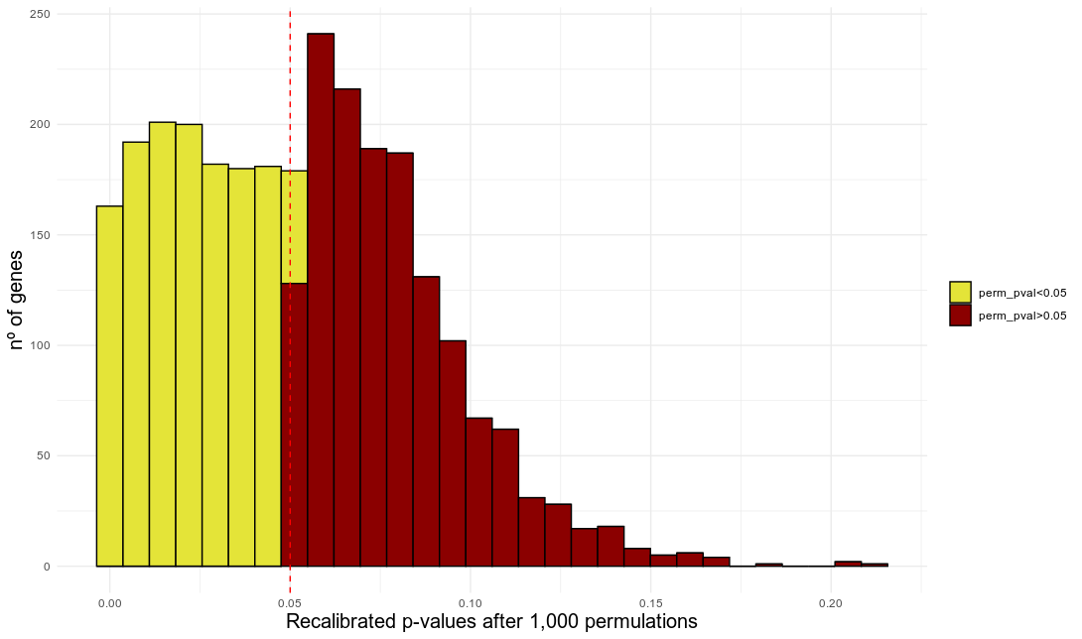
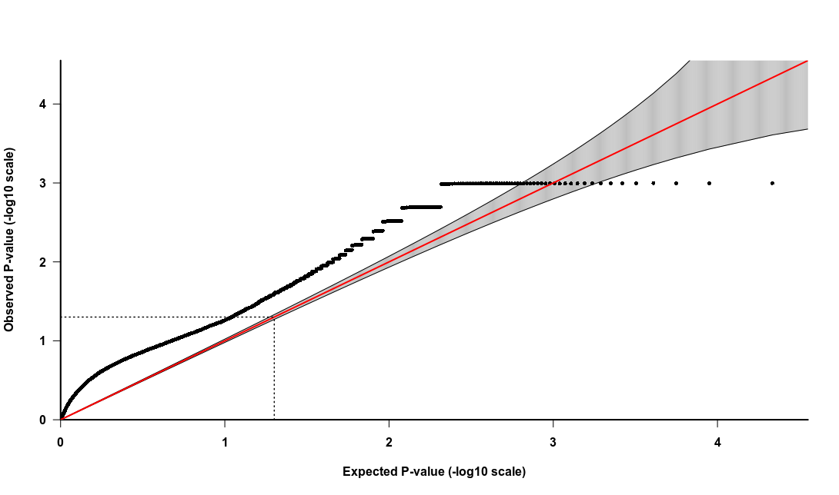
Neoplasia Prevalence
permuLated regressions
permuLations for nominally significant SNPs
parametric PGLS p-value < 0.05
permuLation empirical p-values
1,350 genes with permuLation p-value <0.05 & parametric PGLS p-value <0.05 (48.31% all nominally significant p-values)

Slide 29
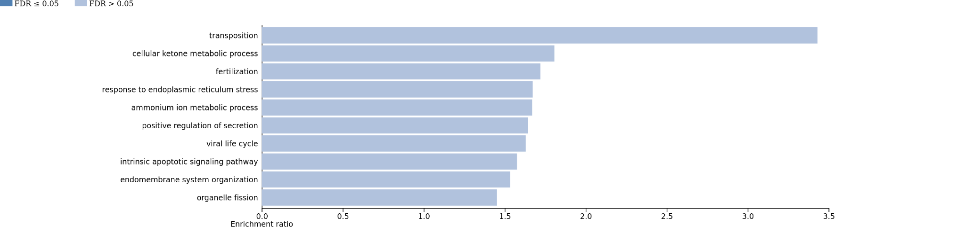
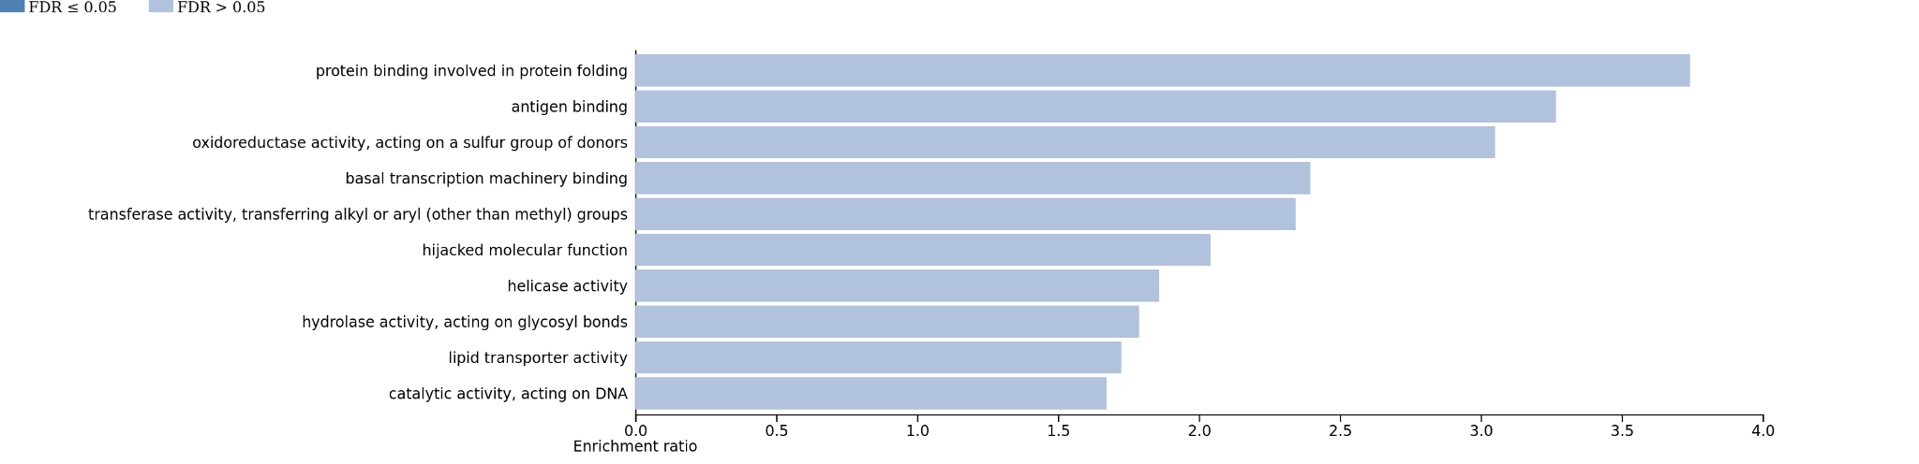
Neoplasia Prevalence
functional enrichment
In-silico functional analysis
Biological process
GO enrichment analysis
WebGestalt
http://www.webgestalt.org/
(Analysis performed upon Discovered CAAS)
Reference set to 16,343 genes
Molecular function

Slide 30
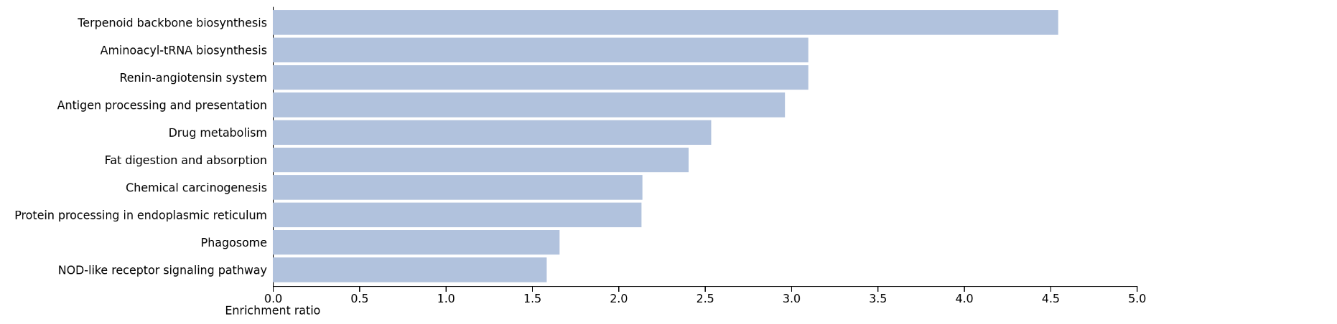
Neoplasia Prevalence
functional enrichment
In-silico functional analysis
Pathway enrichment analysis
WebGestalt
http://www.webgestalt.org/
(Analysis performed upon Discovered CAAS)
Reference set to 16,343 genes
KEGG 2021: Biological pathways

Slide 31
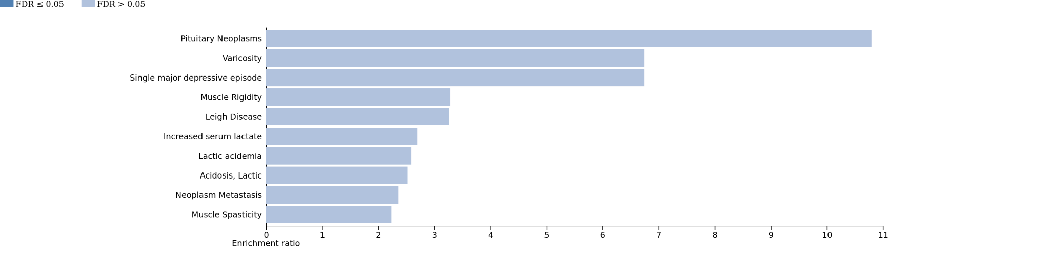
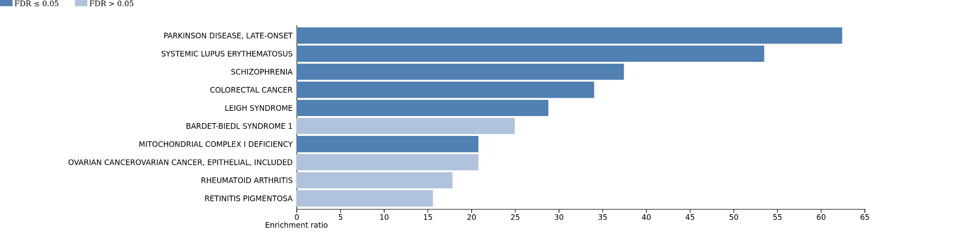
In-silico functional analysis
Pathway and disease enrichment analysis
WebGestalt
http://www.webgestalt.org/
(Analysis performed upon Discovered CAAS)
Reference set to 16,343 genes
Neoplasia Prevalence
functional enrichment
Disgenet & OMIM
diseases

Slide 32
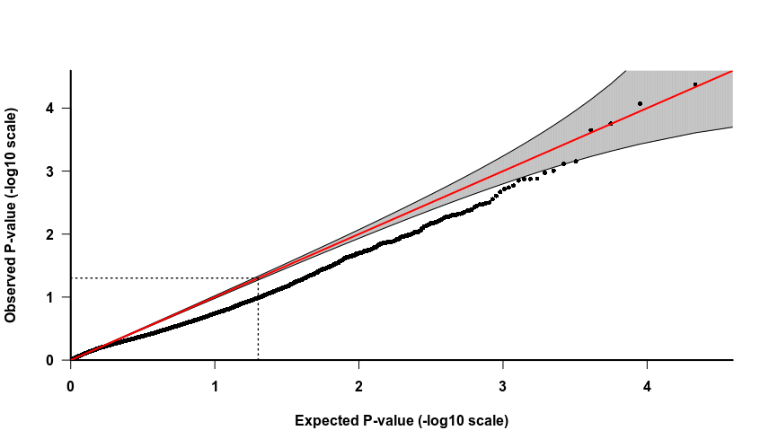
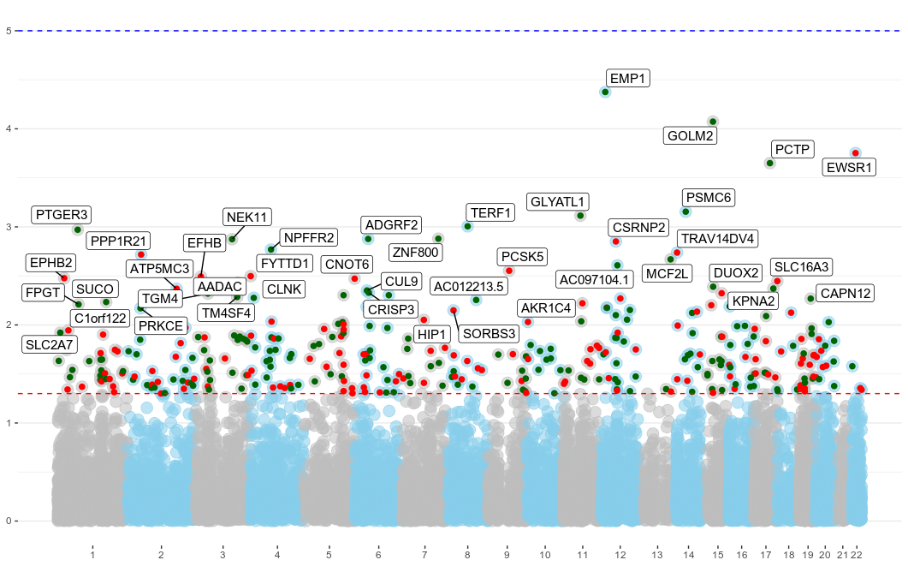
Malignancy Prevalence
parametric p-values
No excess of low p-values but Top ranked genes with close cancer links

Slide 33
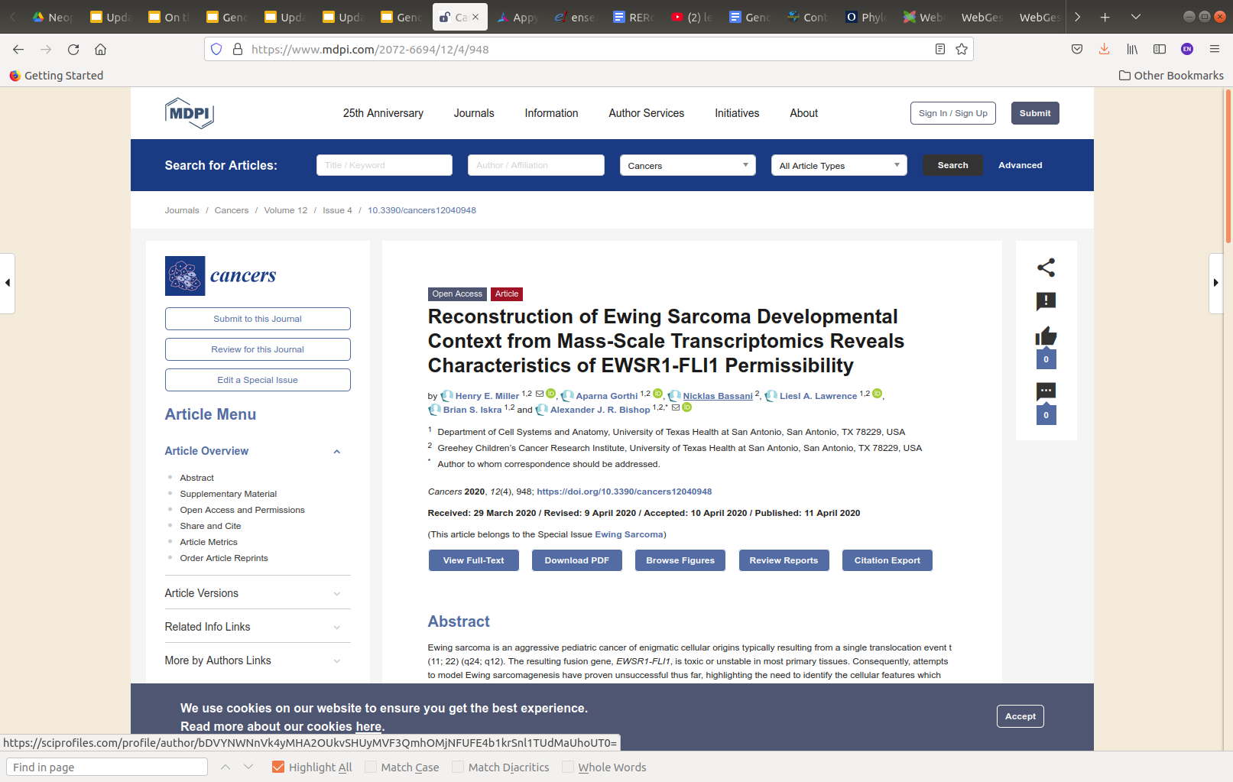
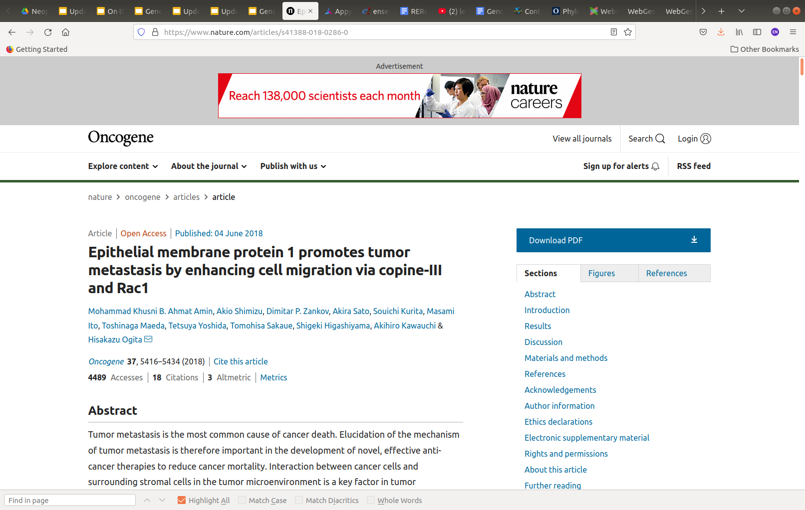
Malignancy Prevalence
parametric p-values

Slide 34
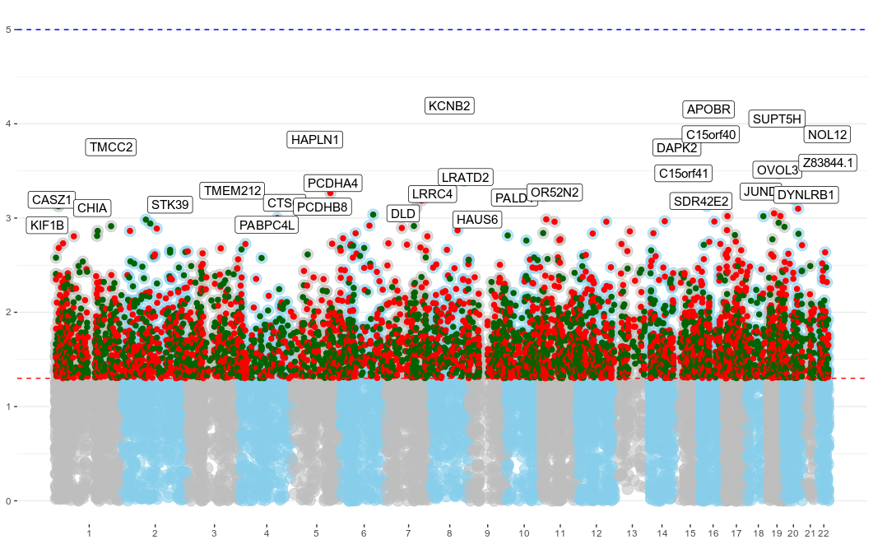
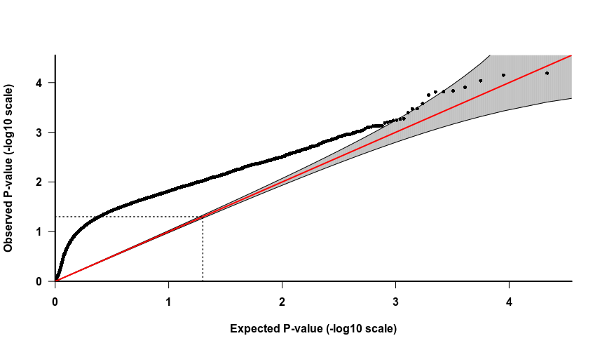
Benignancy Prevalence
parametric p-values
Bonferroni
threshold
P-VAL <0.05 threshold
observed p-value (-log10 scale)
gene-trait correlations
gene-trait correlations
expected p-value (-log10 scale)

Slide 35
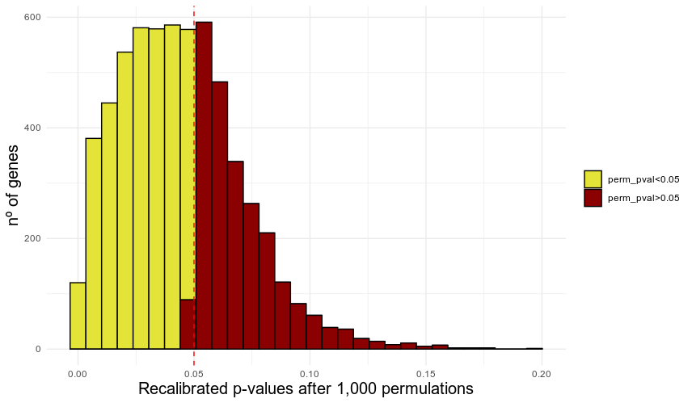
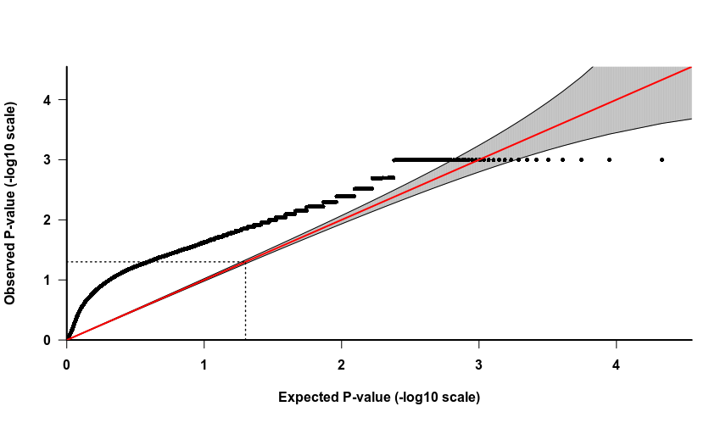
Benignancy Prevalence
permulated associations
permuLations for nominally significant SNPs
parametric PGLS p-value < 0.05
3,718 genes with permuLation p-value <0.05 & parametric PGLS p-value <0.05 (60.6% all nominally significant p-values)

Slide 36
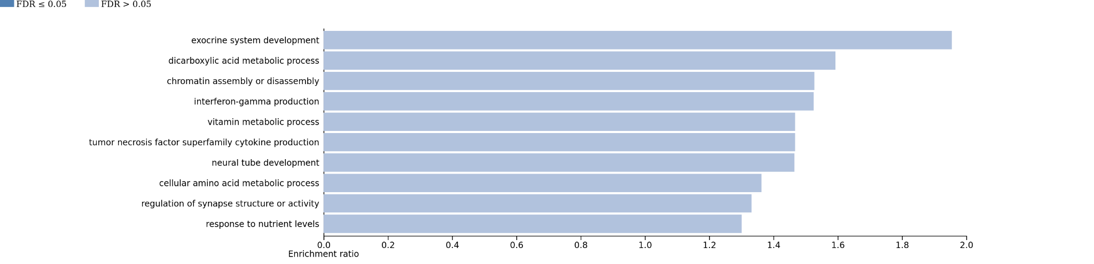
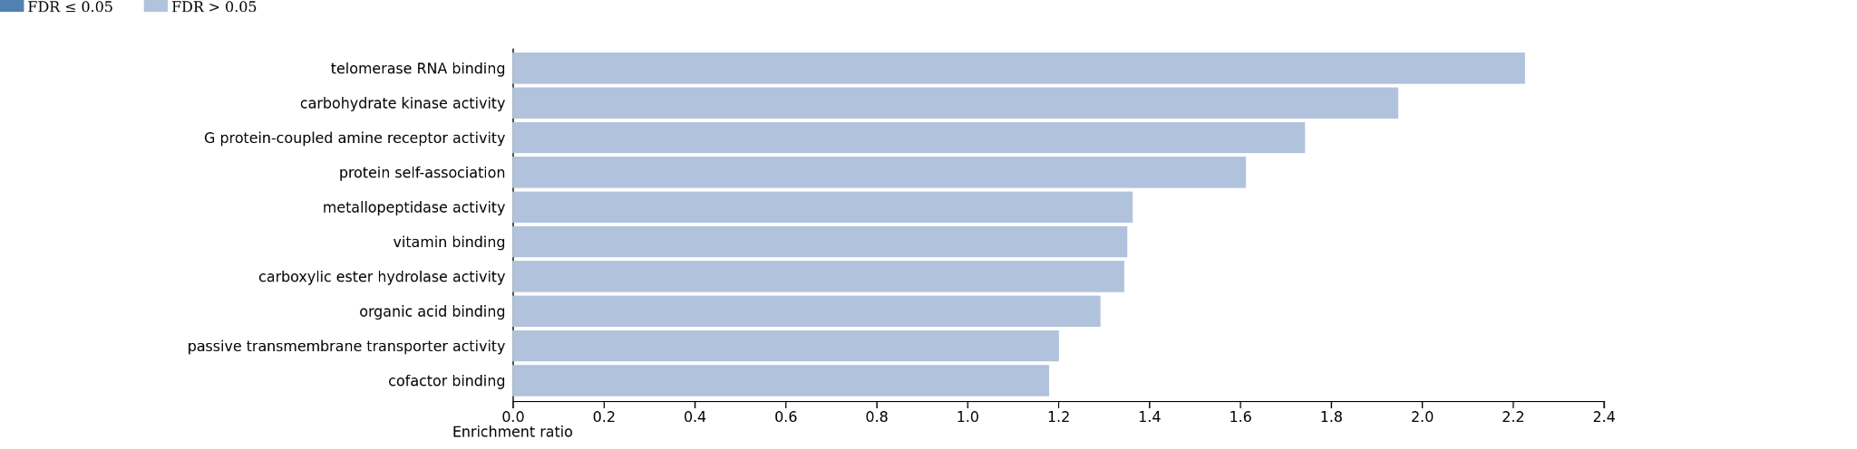
Benignancy Prevalence
functional enrichment
In-silico functional analysis
Biological process
GO enrichment analysis
WebGestalt
http://www.webgestalt.org/
(Analysis performed upon Discovered CAAS)
Reference set to 16,343 genes
Molecular function

Slide 37
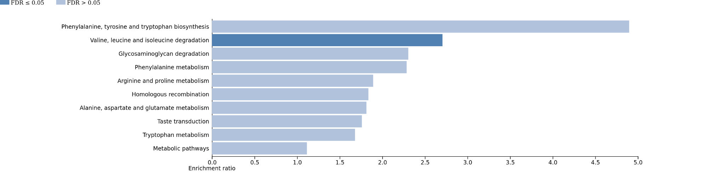
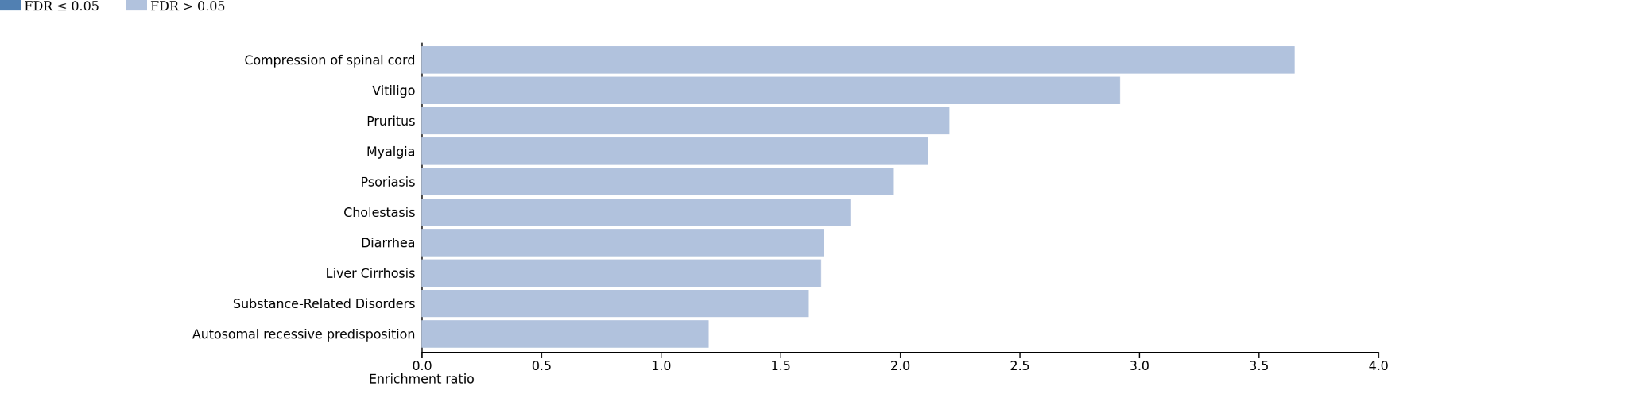
Benignancy Prevalence
functional enrichment
In-silico functional analysis
KEGG 2021: Biological pathways
Pathway and disease analysis
WebGestalt
http://www.webgestalt.org/
(Analysis performed upon Discovered CAAS)
Reference set to 16,343 genes
Disgenet diseases

Slide 38
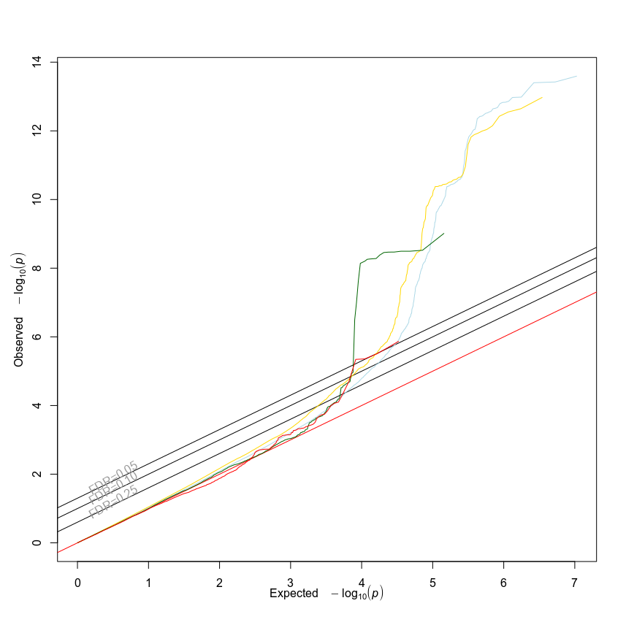
Future steps
Look for more neoplasm-related summary statistics from human GWAS and ascertain the proportions of heritability explained by our validated genesets.
Malignancy measurements
All SNPs
SNPs in primates alignments (5kb range)
SNPs in CAAS genes
SNPs in PGLS genes with parametric & empirical p-val < 0.05
Example:
Cancers diagnosed by doctor: Malignant, primary site
(GWAS Atlas ID: 3329)
PROVISIONAL

Slide 39
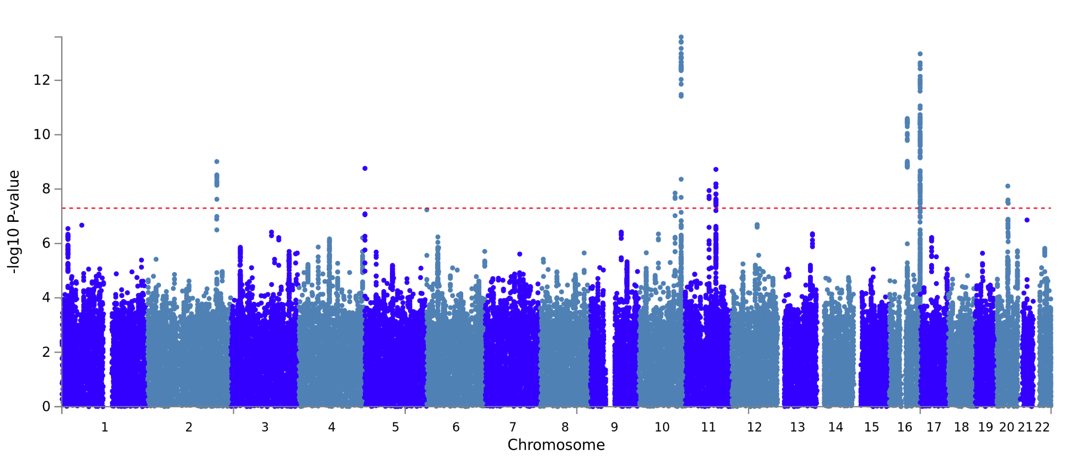
Future steps
Look for more neoplasm-related summary statistics from human GWAS and ascertain the proportions of heritability explained by our validated genesets.
Example:
Cancers diagnosed by doctor: Malignant, primary site
(GWAS Atlas ID: 3329)
Category | Prop SNPs | Prop h2 | Enrichment | Enrichment_p
PGLS p < 0.05 | 0.0738 | 0.1482 | 2.009 | 0.0898
PROVISIONAL

Slide 40
Final Summary
Neoplasia Prevalence appears is the trait with the largest # of links with neoplasm annotation databases fort both, the CAAS and PGLS methodologies
Top ranked genes from Neoplasia and Malignancy Prevalence correlation analysis also play roles in some cancer subtypes (e.g., KLK3 / TNFRFS10D / HBP1 /EWSR1..)
Most of the associated genesets are enriched for aminoacid synthesis, fatty acid absoption, inflamassome complex and apoptosis-related pathways biological categories

Slide 41


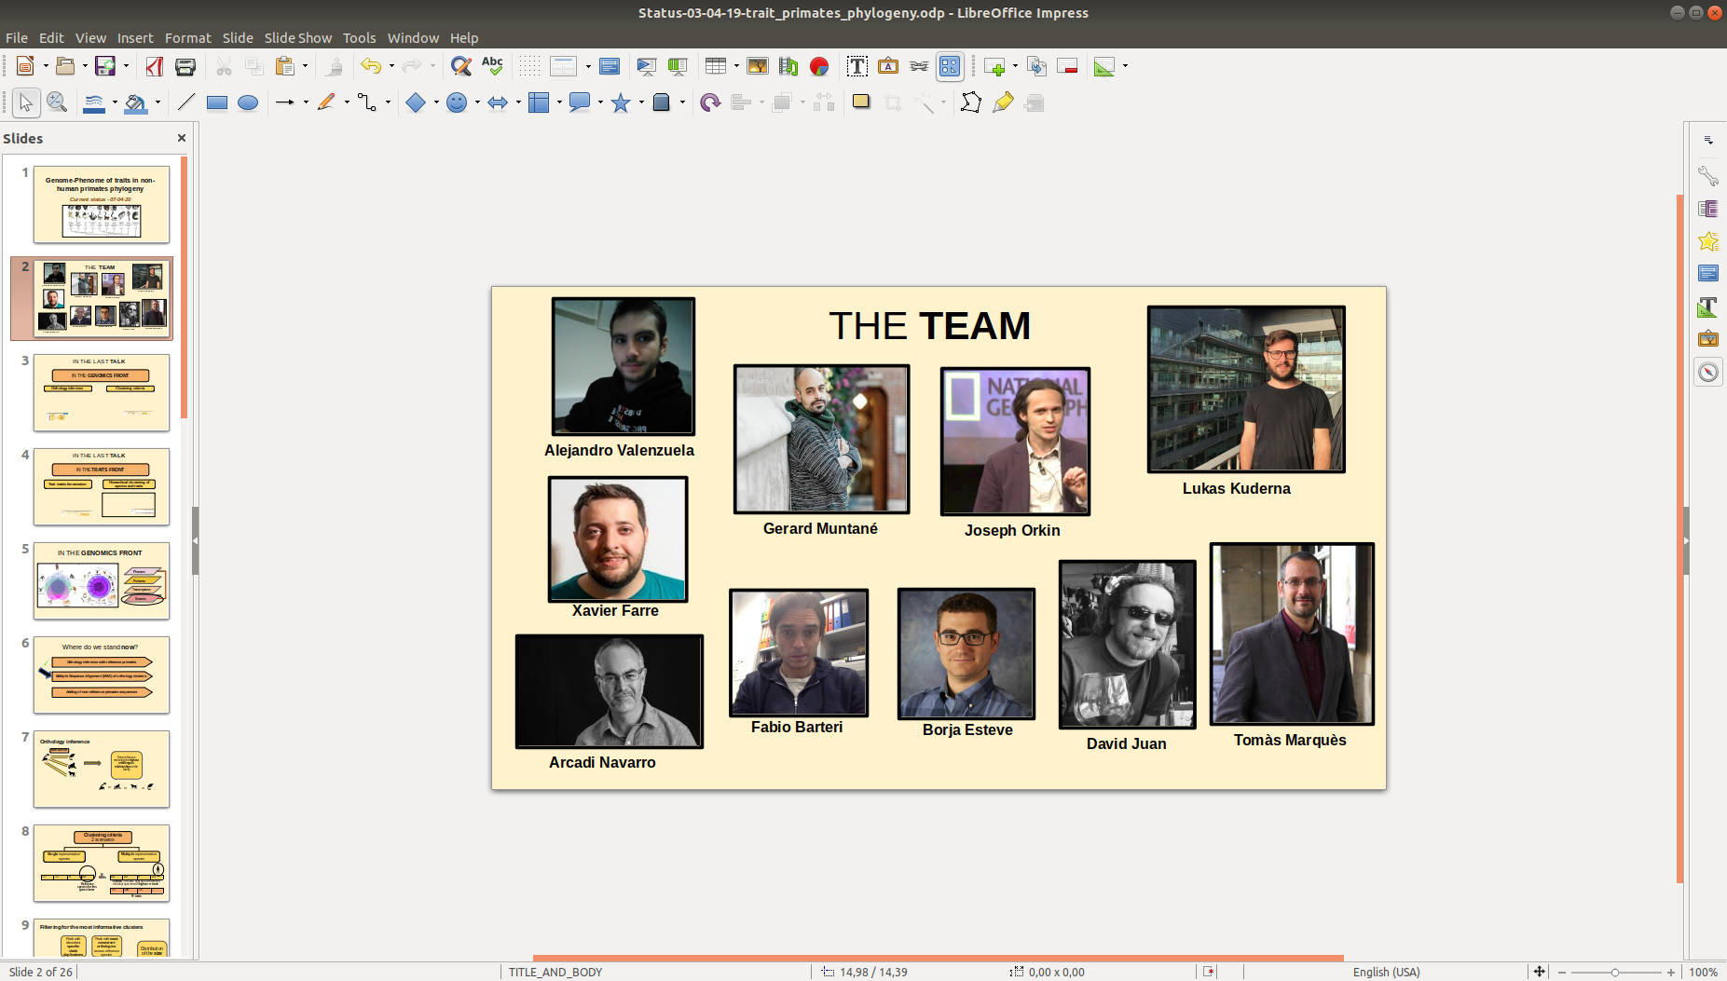
Acknowledgements
Comparative and
Evolutionary Genomics Lab
Arcadi Navarro
Gerard Muntané
David Juan

Slide 42

Any questions?
Thanks!!

